Slide 1
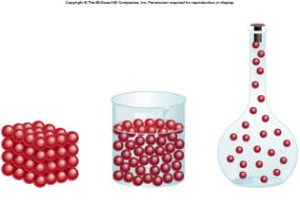
Liquids and Solids

Slide 2
Gases – A quick review
The Kinetic Molecular Theory
Gas particles are considered to be small, hard spheres with insignificant volume.
Gas particles have constant, rapid, random motion.
All collisions between gas particles are perfectly elastic.

Slide 3
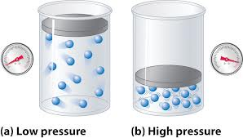
Gas Pressure
Gases have pressure as a result of the force of gas particles “pushing” on an object.
Vacuum – empty space with no particles and therefore no pressure.

Slide 4
Kinetic Energy and Temperature
When a substance is heated
1. 2.
Increase in the or Increase in the
Potential energy Kinetic energy
*Stored energy * Energy of motion
*Does not raise T *Does raise T
*Results in phase change *Results in T change
Cannot increase PE and KE at the same time!!!!!!!!!!!

Slide 5
The Kelvin temperature scale reflects the relationship between temperature and kinetic energy.
The Kelvin temperature of a substance is directly proportional to the average kinetic energy of the substance.
Kinetic
Energy
(kilojoules)
Temperature (Kelvin)

Slide 6
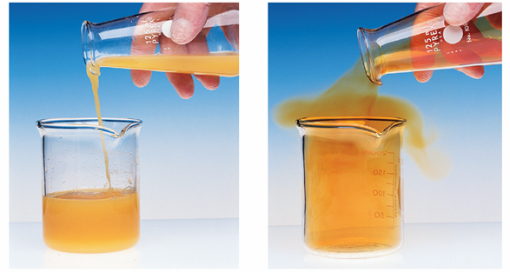
Gases and liquids are classified as fluids because they can flow.
Fluidity is the reason gases and liquids conform to the shape of the container.

Slide 7
Main difference between gases and liquids:
The particles in a liquid are attracted to each other by forces known as intermolecular attractions or
Intermolecular Forces (IMFs)

Slide 8
IMFs responsible for some of the most important properties of liquids:
Liquids have a definite volume.
2. Liquids are much more dense than gases. Liquids, like solids, are not compressible.

Slide 9
Liquids have surface tension. Liquids with strong IMFs, like water, have high surface tension.
Liquids have a wide range of boiling points. The stronger the IMFs, the higher the boiling point.

Slide 10
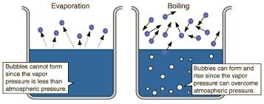
Vaporization
the conversion of a liquid to a gas
includes evaporation and boiling

Slide 11
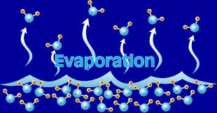
Evaporation is a surface phenomenom.
Only those molecules with a certain minimum amount of KE can escape from the surface of the liquid. Heating increases the average KE of the particles and the rate of evaporation.

Slide 12
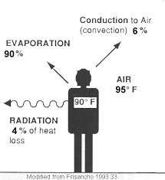
The particles with the highest KE escape
first. This lowers the average KE of the liquid
phase.
As evaporation takes place, the liquids
temperature decreases. Evaporation is a
cooling process.

Slide 13
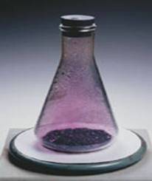
The gas phase of
a substance that
is normally a liquid
or solid is
called a vapor.

Slide 14
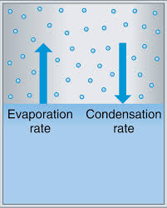
In a closed system, a dynamic liquid/vapor equilibrium will develop.
The system is considered to be at equilibrium because the number of particles vaporizing equals the number of particles condensing.

Slide 15
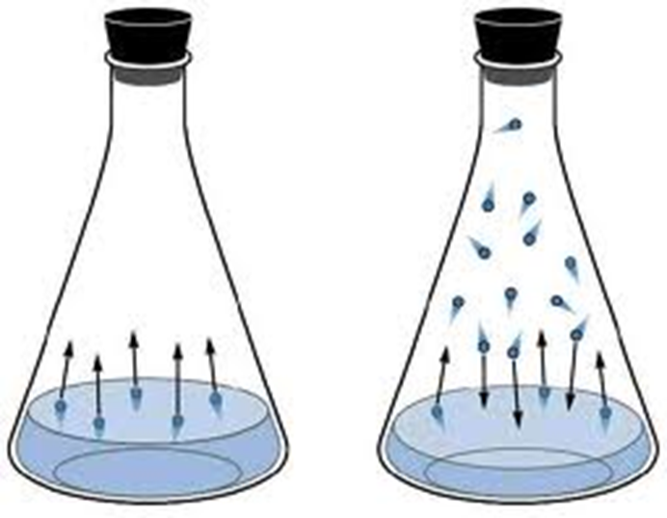
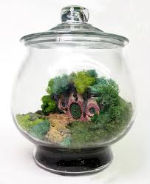
The system is called dynamic because particles continue to evaporate and condense without a net change in the number of particles in the liquid or vapor phase.

Slide 16
Vapor pressure can be measured with a manometer.

Slide 17
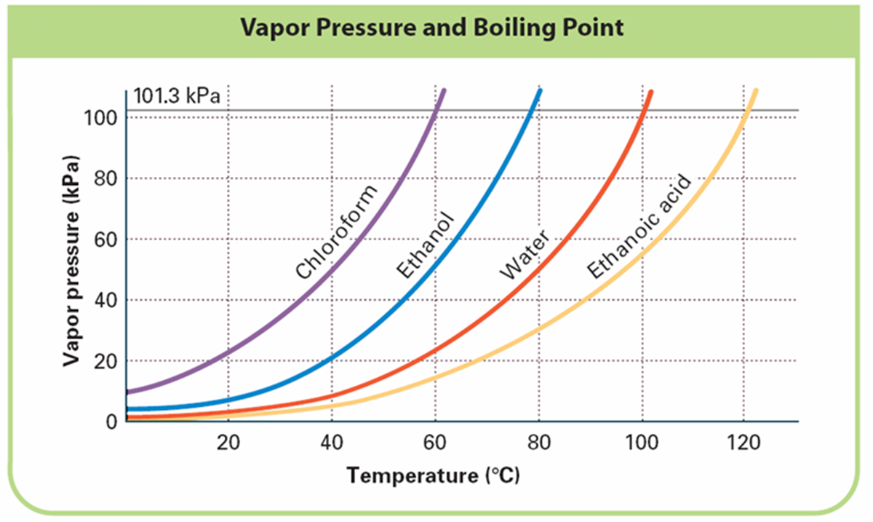
Liquids that have few or weak intermolecular forces evaporate easily and will have high vapor pressure. These liquids are called volatile liquids.

Slide 18
Equilibrium vapor pressure increases as temperature increases.

Slide 19
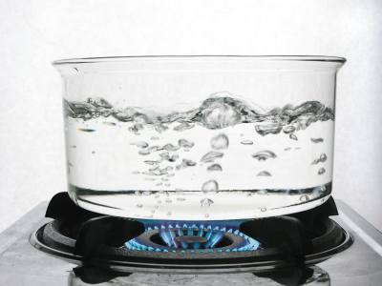
Boiling
The conversion of a liquid to a vapor within the liquid as well as at the surface is known as boiling.
Boiling occurs when the vapor pressure of the liquid is equal to atmospheric pressure.

Slide 20
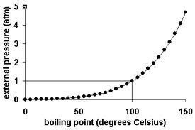
The temperature at which boiling occurs is called the boiling point.

Slide 21
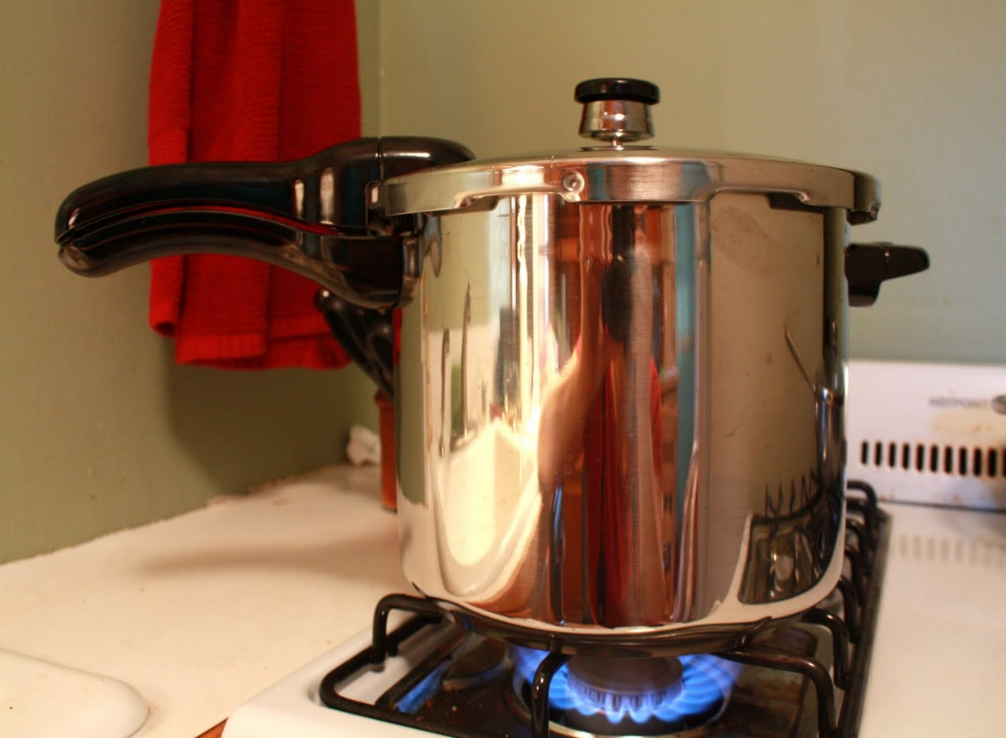
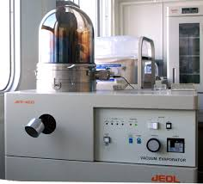
The boiling point of a liquid is directly proportional the the vapor pressure over the liquid.
Pressure cooker
Vacuum evaporator

Slide 22
Boiling point varies with atmospheric pressure.
The greater the pressure on the surface of the liquid, the more energy is required for particles to vaporize (the more energy required to boil).

Slide 23
Normal boiling point is the temperature at which a liquid boils at normal atmospheric pressure (1 atm, 101.3 kPa, 760 mmHg).
The normal boiling point of water is equal to 100 degrees Celsius.

Slide 24
General Properties of SOLIDS
Definite shape, definite volume
Orderly arrangement of particles; particles have a fixed location
Particles (atoms, ions, or molecules) are packed tightly together. Solids are dense and not easily compressed.
Particles vibrate around a fixed point; particles do not flow

Slide 25
When you heat a solid….
Particles vibrate more rapidly as KE increases.
Organization of particles breaks down.
Solid melts

Slide 26
Melting point – temperature at which a solid changes into a liquid.
Freezing point – temperature at which a liquid changes into a soid.
The melting point and the freezing point of a substance are the same temperature.

Slide 27
Normal Freezing Point = Normal Melting Point
Temperature at which a solid and liquid are in equilibrium at 1 atm
Temperature at which the particles of the liquid and solid have the same kinetic energy, therefore the energy lost during freezing is a loss of potential energy.
“stored energy”
(associated with a phase change)

Slide 28
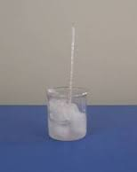
Beaker of ice and water at 0°C
Is the water freezing or is the ice melting?

Slide 29
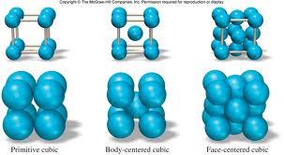
Most solids are crystalline.
The smallest repeatable unit of a crystal is called the unit cell.

Slide 30
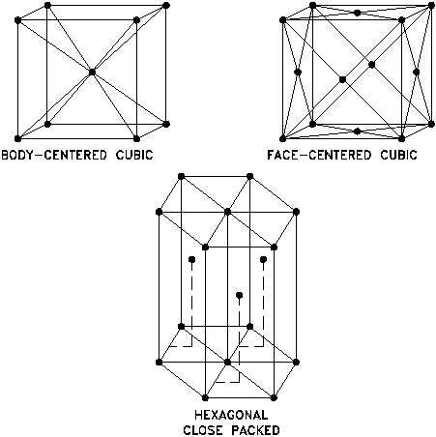
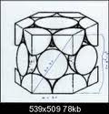
Unit cells

Slide 31
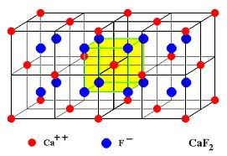
Crystal lattice

Slide 32
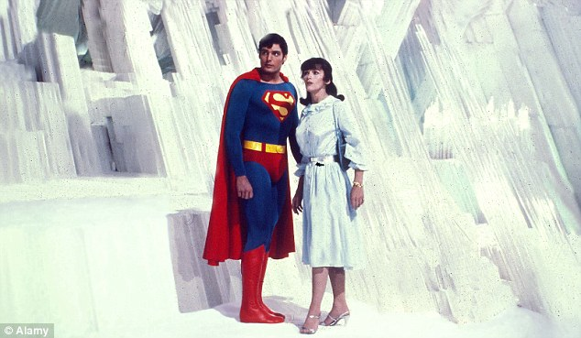
Crystals can be really big!

Slide 33
Gypsum and selenite crystals in Chihuahua, Mexico

Slide 34
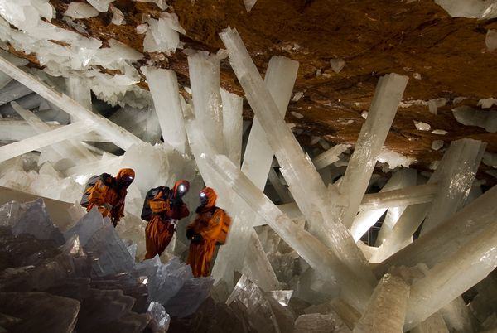
These crystals took 600,000 years to form. The largest is 39 meters long.

Slide 35
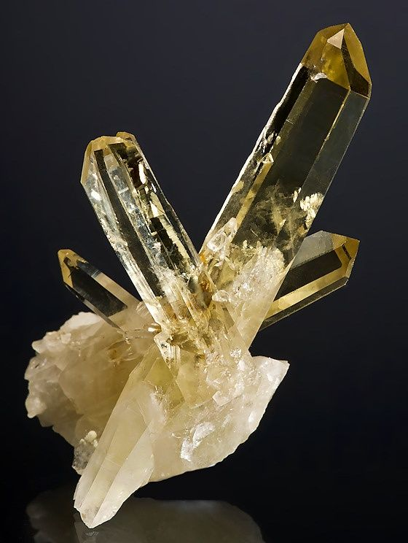
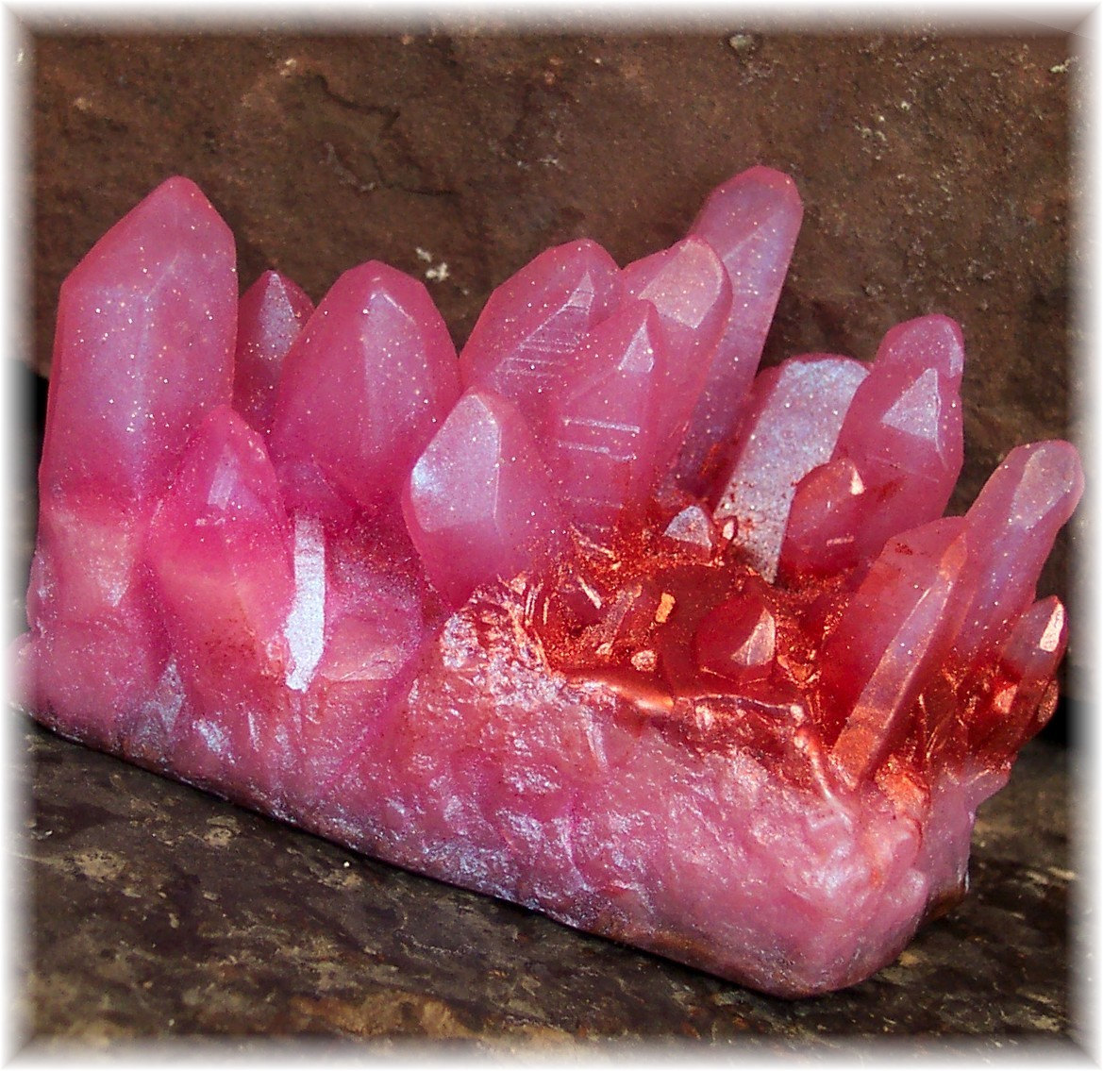

Slide 36
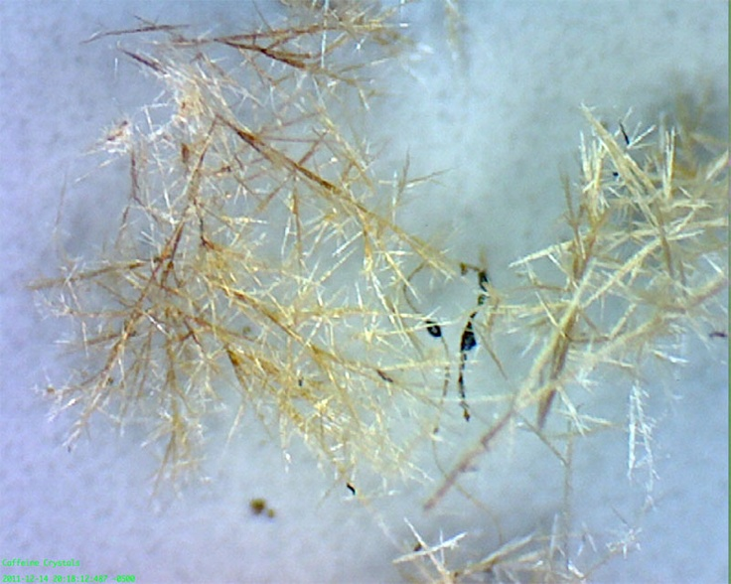
Crystals can be really small! These are caffeine crystals under a microscope.

Slide 37
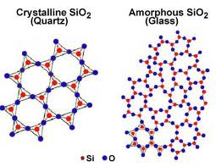
Solids that do not have a crystal structure are called AMORPHOUS.
without form

Slide 38
Amorphous – without a regular crystal structure.

Slide 39
Allotropes
Definition – Solid substances that exist in more than one form.
Allotropes of carbon – diamond, graphite, fullerenes (man-made)
Allotropes of oxygen – oxygen gas (O₂) and ozone (O₃)
Not many elements have allotropes – C, P, S, O, B, Sb

Slide 40
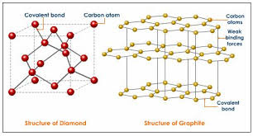
Allotropes of Carbon

Slide 41
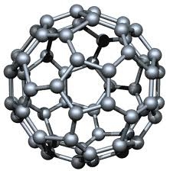
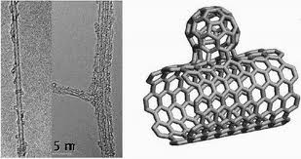
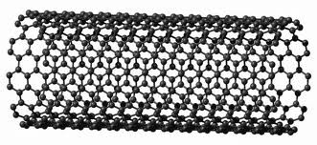
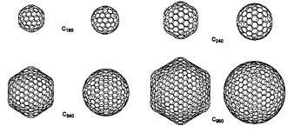
Fullerenes

Slide 42
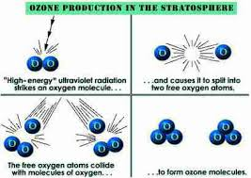
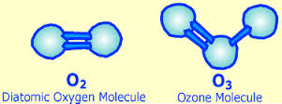
Allotropes of Oxygen

Slide 43
Changes of State
Phase changes that result from a LOSS of energy are EXOTHERMIC.
Freezing (liquid to solid)
Condensation (gas to liquid)
Deposition (gas to solid)

Slide 44
Phase changes resulting from a GAIN of energy are called ENDOTHERMIC processes.
Melting (solid to liquid)
Vaporization (liquid to gas)
Sublimation (solid to gas)

Slide 45
Phase Diagram of Water

Slide 46
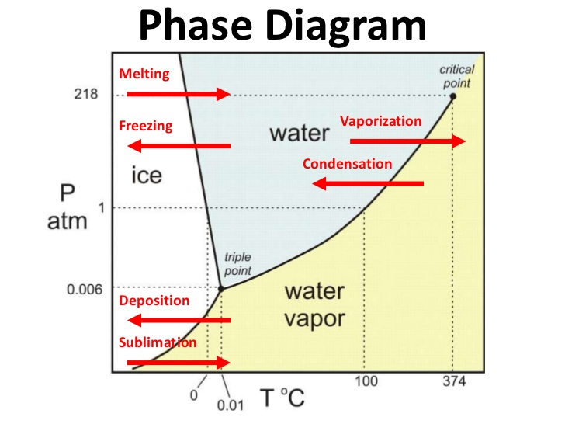

Slide 49
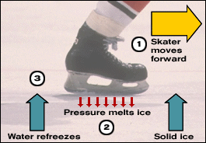

Slide 50
Triple point – the only T and P where all three states can exist in equilibrium with one another.

Slide 51
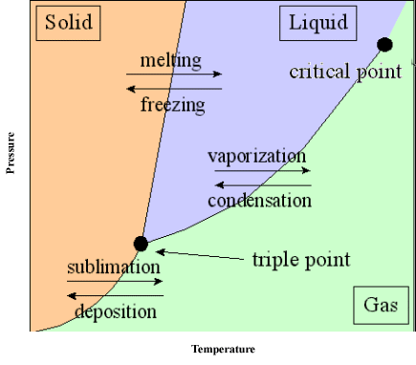
Critical point – above this T, no amount of P will liquefy the gas
Phase diagram for anything other than water

Slide 52
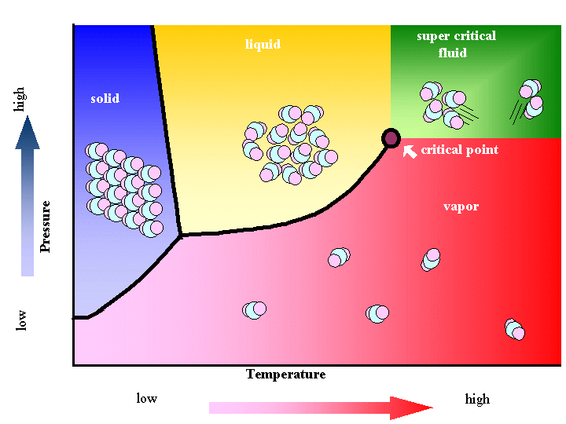

Slide 53
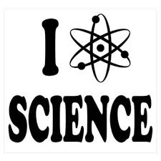
THE END

