Slide 1
Thermochemistry notes (part 2)

Slide 2
Calorimetry
Since we cannot know the exact enthalpy of the reactants and products, we measure ΔH through calorimetry, the measurement of heat flow.

Slide 3
Quantity of Heat Energy Absorbed Heat Capacity
When a system absorbs heat, its temperature increases.
The increase in temperature is directly proportional to the amount of heat absorbed.
The proportionality constant is called the heat capacity, C.
Units of C are J/°C or J/K.
q = C × ΔT
The heat capacity of an object depends on its mass.
200 g of water requires twice as much heat to raise its temperature by 1 °C as does 100 g of water.
The heat capacity of an object depends on the type of material.
1000 J of heat energy will raise the temperature of 100 g of sand 12 °C, but only raise the temperature of 100 g of water by 2.4 °C.

Slide 4
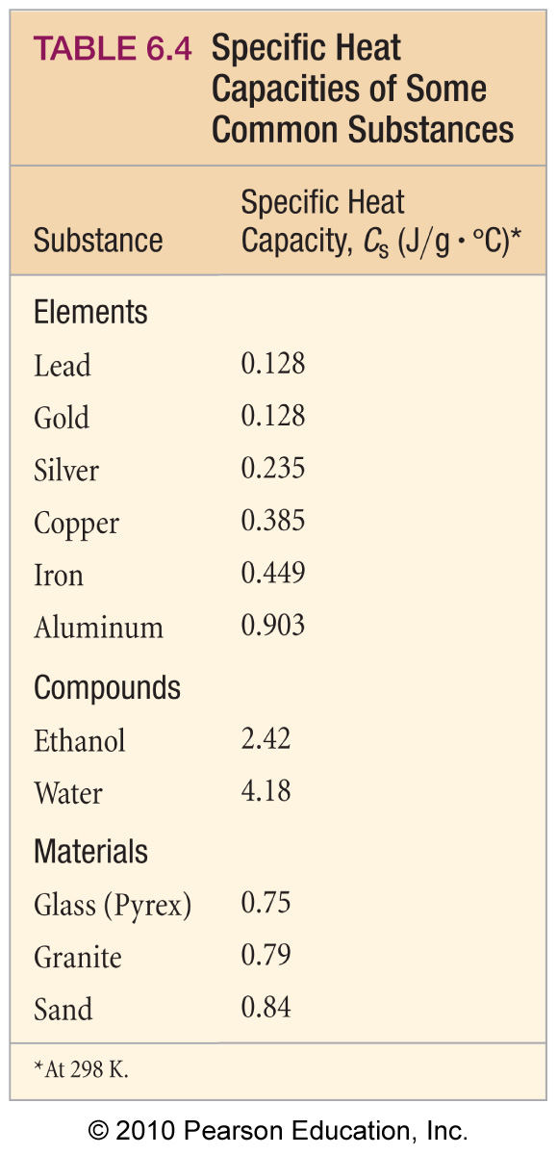
Specific Heat Capacity
measure of a substance’s intrinsic ability to absorb heat
The specific heat capacity is the amount of heat energy required to raise the temperature of one gram of a substance 1 °C.
C_{s} or c_{p} or s
units are J/(g∙°C)
The molar heat capacity is the amount of heat energy required to raise the temperature of one mole of a substance 1 °C.

Slide 5
Quantifying Heat Energy
The heat capacity of an object is proportional to its mass and the specific heat of the material.
So we can calculate the quantity of heat absorbed by an object if we know the mass, the specific heat, and the temperature change of the object.
heat = (mass) × (specific heat capacity) × (temp. change)
q = (m) × (C_{s}) × (ΔT)

Slide 6
Heat Capacity and Specific Heat
Specific heat, then, is
heat transferred
Specific heat =
mass × temperature change
q
Cs =
m × ΔT

Slide 7
A piece of zinc weighing 35.8 g was heated from 20.00°C to 28.00°C. How much heat was required? The specific heat of zinc is 0.388 J/(g°C).
m = 35.8 g
s = 0.388 J/(g°C)
Δt = 28.00°C – 20.00°C = 8.00°C
q = m  Cs  Δt
q = 111 J
(3 significant figures)

Slide 8
Sample Exercise 5.5 Relating Heat, Temperature Change, and Heat Capacity
(a) How much heat is needed to warm 250 g of water (about 1 cup) from 22 °C (about room temperature) to 98 °C (near its boiling point)? (b) What is the molar heat capacity of water?
Solution
Analyze In part (a) we must find the quantity of heat (q)
needed to warm the water, given the mass of water (m),
its temperature change (ΔT), and its specific heat (C_{s}). In
part (b) we must calculate
the molar heat capacity (heat capacity per mole, C_{m}) of
water from its specific heat (heat capacity per gram).
Plan (a) Given C_{s}, m, and ΔT, we can calculate the quantity of heat, q, using Equation 5.22. (b) We can use the molar
mass of water and dimensional analysis to convert from heat capacity per gram to heat capacity per mole.
Solve
(a) The water undergoes a temperature change of
Using Equation 5.22, we have
(b) The molar heat capacity is the heat capacity of one
mole of substance. Using the atomic weights of
hydrogen and oxygen, we have
From the specific heat given in part (a), we have
ΔT = 98 °C – 22 °C = 76 °C = 76 K
q = C_{s} × m × ΔT
= (4.18 J/g–K)(250 g)(76 K) = 7.9 × 10⁴ J
1 mol H₂O = 18.0 g H₂O
Notes:
8

Slide 9
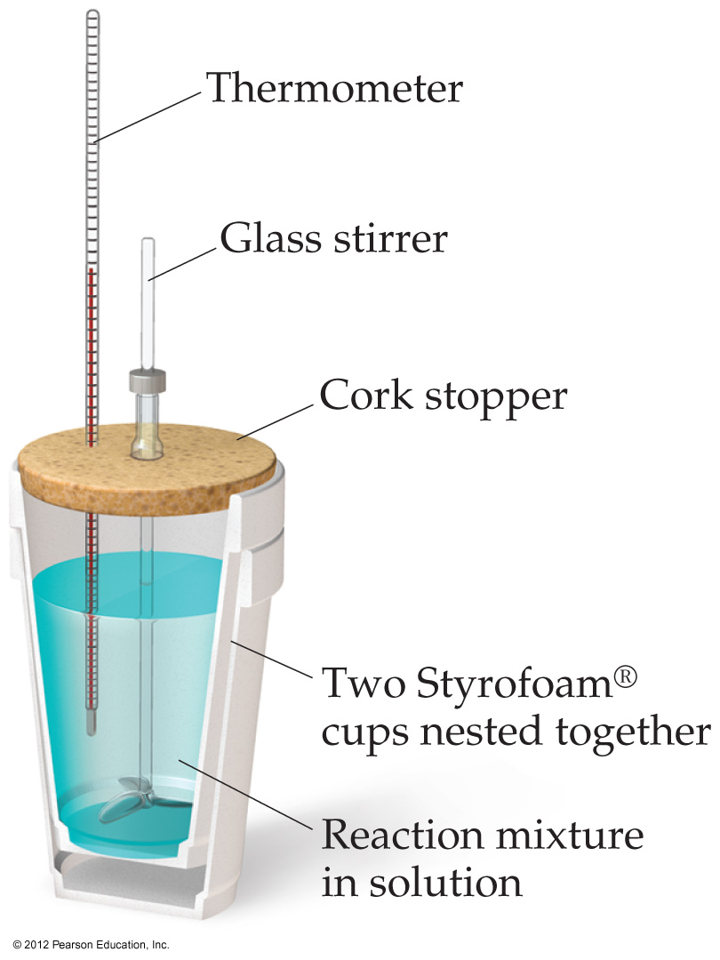
Constant Pressure Calorimetry
By carrying out a reaction in aqueous solution in a simple calorimeter such as this one, one can indirectly measure the heat change for the system by measuring the heat change for the water in the calorimeter.

Slide 10
Constant Pressure Calorimetry
A styrofoam cup calorimeter is considered to be an isolated system.
Heat lost Heat gained
by the = by the
reaction water

Slide 11
Constant Pressure Calorimetry
Because the specific heat for water is well known (4.184 J/g-K), we can measure ΔH for the reaction with this equation:
q = m × Cs × ΔT

Slide 12
Sample Exercise 5.6 Measuring ΔH Using a Coffee-Cup Calorimeter
When a student mixes 50 mL of 1.0 M HCl and 50 mL of 1.0 M NaOH in a coffee-cup calorimeter, the temperature of the resultant solution increases from 21.0 °C to 27.5 °C. Calculate the enthalpy change for the reaction in kj/mol HCl, assuming that the calorimeter loses only
a negligible quantity of heat, that the total volume of the solution is 100 mL, that its density is
1.0 g/mL, and that its specific heat is 4.18 J/g–K.
Solution
Analyze Mixing solutions of HCl and NaOH results in an acid–base reaction:
HCl(aq) + NaOH(aq) H₂O(l) + NaCl(aq)
We need to calculate the heat produced per mole of HCl, given the temperature increase of the solution, the number
of moles of HCl and NaOH involved, and the density and specific heat of the solution.
Plan The total heat produced can be calculated using Equation 5.23. The number of moles of HCl consumed in the
reaction must be calculated from the volume and molarity of this substance, and this amount is then used to determine
the heat produced per mol HCl.
Solve
Because the total volume of the solution is 100 mL, its
mass is
The temperature change is
Using Equation 5.23, we have
(100 mL)(1.0 g/mL) = 100 g
ΔT = 27.5 °C – 21.0 °C = 6.5 °C = 6.5 K
q_{rxn} = –C_{s} × m × ΔT
= –(4.18 J/g–K)(100 g)(6.5 K) = –2.7 × 10³ J = –2.7 kJ
Notes:
12

Slide 13
Sample Exercise 5.6 Measuring ΔH Using a Coffee-Cup Calorimeter
Continued
Because the process occurs at constant pressure,
To express the enthalpy change on a molar basis, we use
the fact that the number of moles of HCl is given by the
product of the volume (50mL = 0.050 L) and
concentration (1.0 M = 1.0 mol/L) of the HCl solution:
Thus, the enthalpy change per mole of HCl is
ΔH = q_{P} = –2.7 kJ
(0.050 L)(1.0 mol/L) = 0.050 mol
ΔH = –2.7 kJ/0.050 mol = –54 kJ/mol
Check ΔH is negative (exothermic), which is expected for the reaction of an acid with a base and evidenced by the
fact that the reaction causes the temperature of the solution to increase. The magnitude of the molar enthalpy
change seems reasonable.
Notes:
13

Slide 14
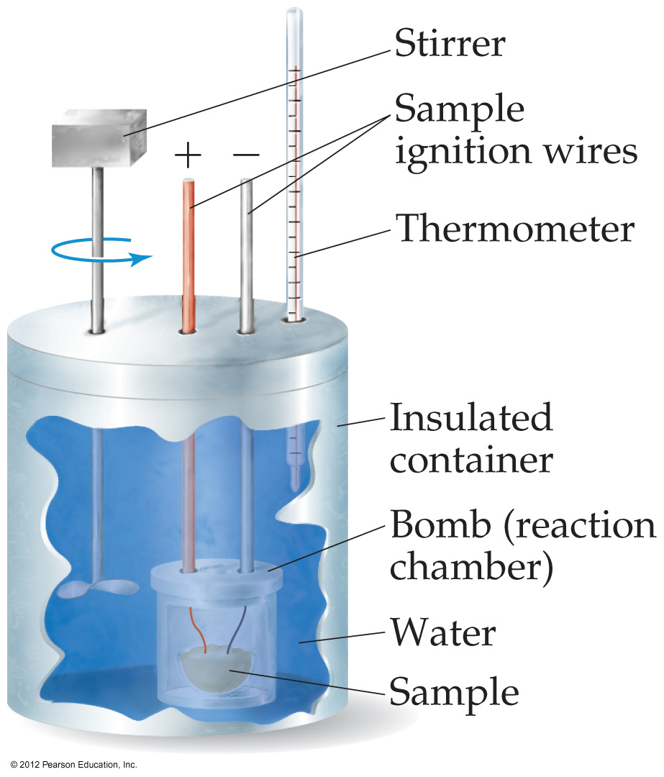
Bomb Calorimetry
Reactions can be carried out in a sealed “bomb” such as this one.
The heat absorbed (or released) by the water is a very good approximation of the enthalpy change for the reaction.

Slide 15
Bomb Calorimetry
Because the volume in the bomb calorimeter is constant, what is measured is really the change in internal energy, ΔE, not ΔH.
For most reactions, the difference is very small.

Slide 16
Sample Exercise 5.7 Measuring q_{rxn} Using a Bomb Calorimeter
The combustion of methylhydrazine (CH₆N₂), a liquid rocket fuel, produces N₂(g), CO₂(g), and H₂O(l):
2 CH₆N₂(l) + 5 O₂(g) 2 N₂(g) + 2 CO₂(g) + 6 H₂O(l)
When 4.00 g of methylhydrazine is combusted in a bomb calorimeter, the temperature of the calorimeter increases
from 25.00 °C to 39.50 °C. In a separate experiment the heat capacity of the calorimeter is measured to be 7.794 kJ/ °C. Calculate the heat of reaction for the combustion of a mole of CH₆N₂.
Solution
Analyze We are given a temperature change and the total heat capacity of the calorimeter. We are also given the
amount of reactant combusted. Our goal is to calculate the enthalpy change per mole for combustion of the reactant.
Plan We will first calculate the heat evolved for the combustion of the 4.00-g sample. We will then convert
this heat to a molar quantity.
Solve
For combustion of the 4.00-g sample of methylhydrazine,
the temperature change of the calorimeter is
We can use ΔT and the value for C_{cal} to calculate the heat
of reaction (Equation 5.24):
We can readily convert this value to the heat of reaction
for a mole of CH₆N₂:
ΔT = (39.50 °C – 25.00 °C) = 14.50 °C
q_{rxn} = –C_{cal} × ΔT = –(7.794 kJ/°C)(14.50 °C) = –113.0 kJ
Notes:
16

Slide 17
Hess’s Law
ΔH is well known for many reactions, and it is inconvenient to measure ΔH for every reaction in which we are interested.
However, we can estimate ΔH using published ΔH values and the properties of enthalpy.

Slide 18
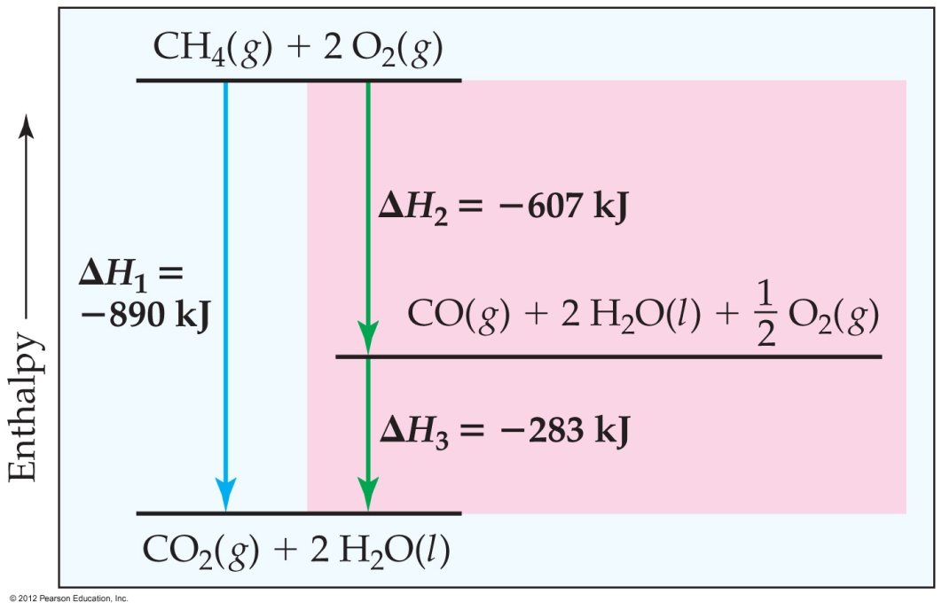
Hess’s Law
Hess’s law states that “if a reaction is carried out in a series of steps, ΔH for the overall reaction will be equal to the sum of the enthalpy changes for the individual steps.”

Slide 19
Hess’s Law
Because ΔH is a state function, the total enthalpy change depends only on the initial state of the reactants and the final state of the products.

Slide 20
Sample Exercise 5.8 Using Hess’s Law to Calculate ΔH
The enthalpy of reaction for the combustion of C to CO₂ is –393.5 kJ/mol C, and the enthalpy for the combustion of CO to CO₂ is –283.0 kJ/mol C:
1.
2.
Using these data, calculate the enthalpy for the combustion of C to CO:
3.
Solution
Analyze We are given two thermochemical equations, and our goal is to combine them in such a way as to obtain the
third equation and its enthalpy change.
Plan We will use Hess’s law. In doing so, we first note the numbers of moles of substances among the reactants and
products in the target equation, (3).We then manipulate equations (1) and (2) to give the same number of moles of
these substances, so that when the resulting equations are added, we obtain the target equation. At the same time, we
keep track of the enthalpy changes, which we add.
Notes:
20

Slide 21
Sample Exercise 5.8 Using Hess’s Law to Calculate ΔH
Continued
Solve To use equations (1) and (2), we arrange them so that C(s) is on the reactant side and CO(g) is on the product
side of the arrow, as in the target reaction, equation (3). Because equation (1) has C(s) as a reactant, we can use that
equation just as it is. We need to turn equation (2) around, however, so that CO(g) is a product. Remember that when
reactions are turned around, the sign of ΔH is reversed. We arrange the two equations so that they can be added to
give the desired equation:
When we add the two equations, CO₂(g) appears on both sides of the arrow and therefore cancels out. Likewise,
½ 0₂ (g) is eliminated from each side.
Notes:
21

Slide 22
Sample Exercise 5.9 Using Three Equations with Hess’s Law to Calculate ΔH
Calculate ΔH for the reaction
2 C(s) + H₂(g) C₂H₂(g)
given the following chemical equations and their respective enthalpy changes:
Solution
Analyze We are given a chemical equation and asked to calculate its ΔH using three chemical equations and their
associated enthalpy changes.
Plan We will use Hess’s law, summing the three equations or their reverses and multiplying each by an appropriate
coefficient so that they add to give the net equation for the reaction of interest. At the same time, we keep track of the
ΔH values, reversing their signs if the reactions are reversed and multiplying them by whatever coefficient is
employed in the equation.
Notes:
22

Slide 23
Sample Exercise 5.9 Using Three Equations with Hess’s Law to Calculate ΔH
Continued
Solve Because the target equation has C₂H₂ as a product, we turn the first equation around; the sign of ΔH is therefore
changed. The desired equation has 2 C(s) as a reactant, so we multiply the second equation and its ΔH by 2. Because
the target equation has H₂ as a reactant, we keep the third equation as it is. We then add the three equations and their
enthalpy changes in accordance with Hess’s law:
When the equations are added, there are 2 CO₂, 5/2 O₂, and H₂O on both sides of the arrow. These are canceled in
writing the net equation.
Notes:
23

Slide 24
Enthalpies of Formation
An enthalpy of formation, ΔH_{f}, is defined as the enthalpy change for the reaction in which one mole of a compound is made from its constituent elements in their elemental forms.

Slide 25
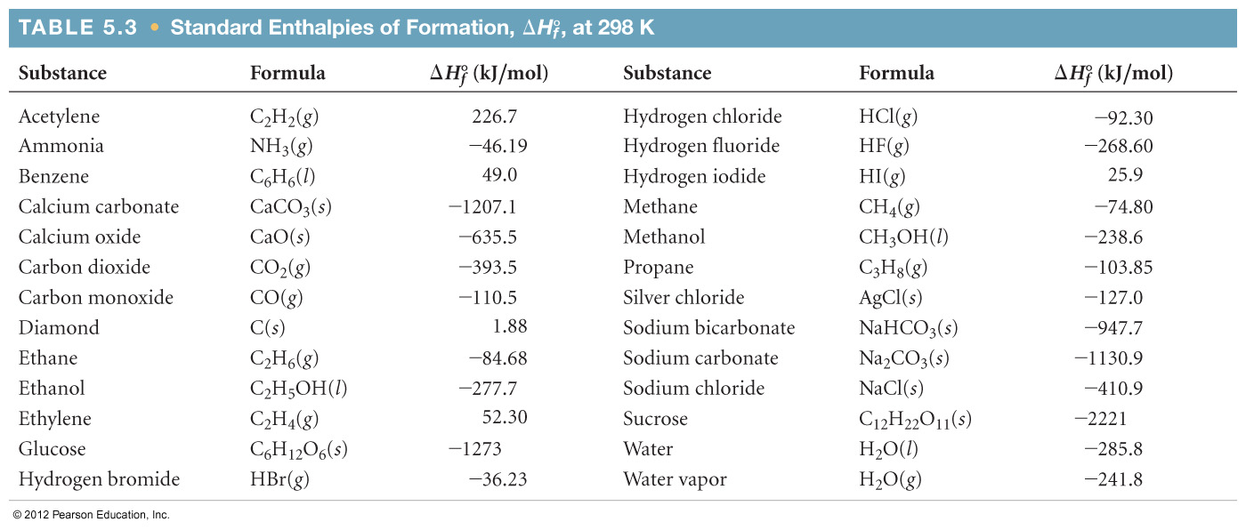
Standard Enthalpies of Formation
Standard enthalpies of formation, ΔH_{f}˚, are measured under standard conditions (25˚C and 1.00 atm pressure).

Slide 26
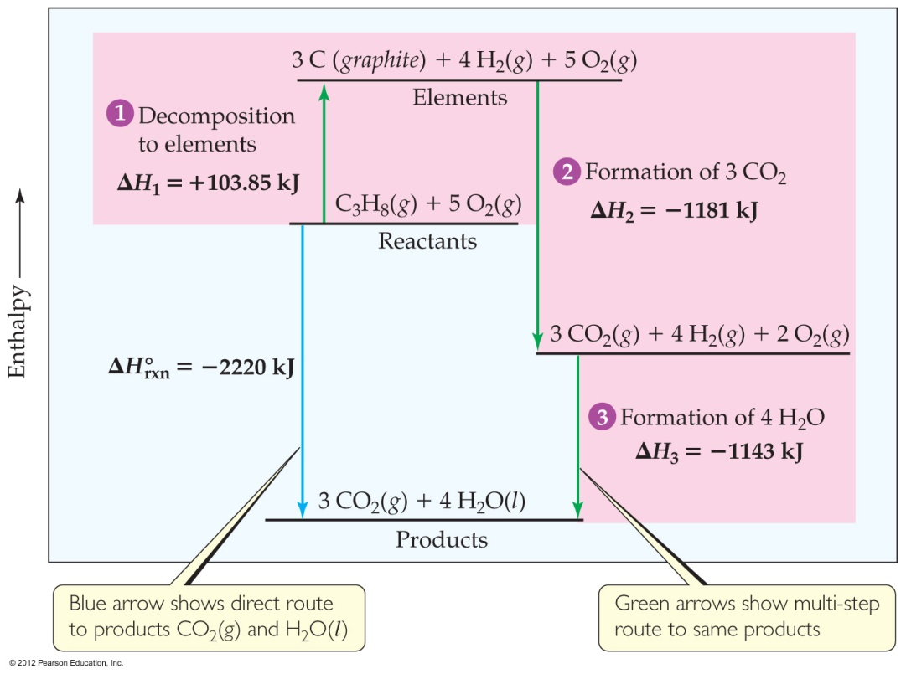
Calculation of ΔH_{r}
C₃H₈(g) + 5O₂(g) ⎯→ 3CO₂(g) + 4H₂O(l)
Imagine this as occurring
in three steps:
C₃H₈(g) ⎯→ 3C_{(graphite)} + 4H₂(g)

Slide 27
Calculation of ΔH_{r}
C₃H₈(g) + 5O₂(g) ⎯→ 3CO₂(g) + 4H₂O(l)
Imagine this as occurring
in three steps:
C₃H₈(g) ⎯→ 3C_{(graphite)} + 4H₂(g)
3C_{(graphite)} + 3O₂(g) ⎯→3CO₂(g)

Slide 28
Calculation of ΔH_{r}
C₃H₈(g) + 5O₂(g) ⎯→ 3CO₂(g) + 4H₂O(l)
Imagine this as occurring
in three steps:
C₃H₈(g) ⎯→ 3C_{(graphite)} + 4H₂(g)
3C_{(graphite)} + 3O₂(g) ⎯→3CO₂(g)
4H₂(g) + 2O₂(g) ⎯→ 4H₂O(l)

Slide 29
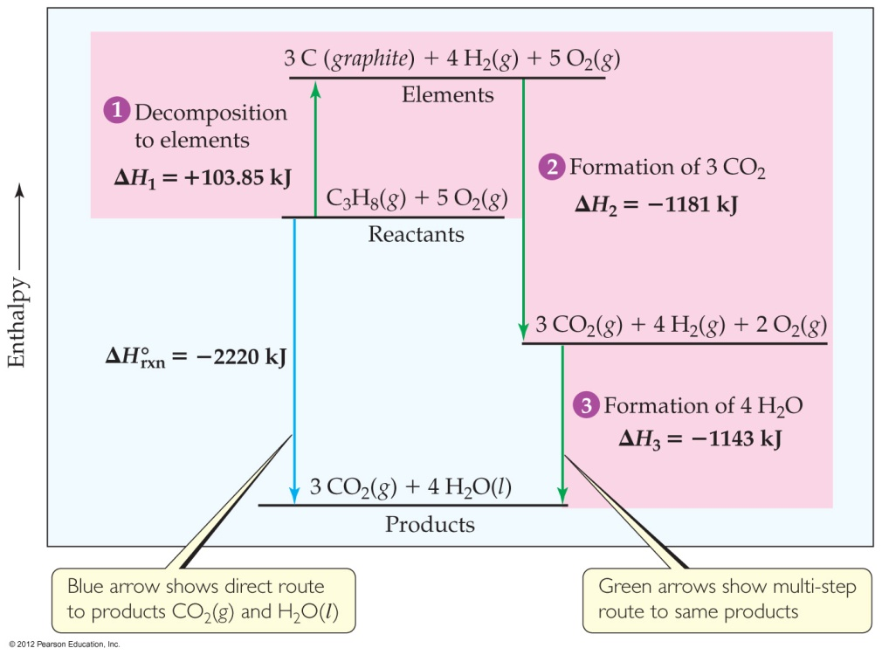
Calculation of ΔH_{r}
C₃H₈(g) + 5O₂(g) ⎯→ 3CO₂(g) + 4H₂O(l)
The sum of these equations is
C₃H₈(g) ⎯→ 3C_{(graphite)} + 4H₂(g)
3C_{(graphite)} + 3O₂(g) ⎯→3CO₂(g)
4H₂(g) + 2O₂(g) ⎯→ 4H₂O(l)
C₃H₈(g) + 5O₂(g) ⎯→ 3CO₂(g) + 4H₂O(l)

Slide 30
Calculation of ΔH_{r}
We can use Hess’s law in this way:
ΔH_{r} = ΣnΔH_{f}˚_{(products)} – ΣmΔH_{f}˚_{(reactants)}
where n and m are the stoichiometric coefficients.

Slide 31
Calculation of ΔH_{r}
C₃H₈(g) + 5O₂(g) ⎯→ 3CO₂(g) + 4H₂O(l)
ΔH = [3(−393.5 kJ) + 4(−285.8 kJ)] – [1(−103.85 kJ) + 5(0 kJ)]
= [(−1180.5 kJ) + (−1143.2 kJ)] – [(−103.85 kJ) + (0 kJ)]
= (−2323.7 kJ) – (−103.85 kJ) = −2219.9 kJ

Slide 32
Foods fuels three needs of the body:
• They supply substances for the growth and repair of tissue.
• They supply substances for the synthesis of compounds used in the regulation processes.
• They supply energy.
Foods do this by a combustion process.

Slide 33
For glucose, a carbohydrate:
C₆H₁₂O₆(s) + 6O₂(g) → 6CO₂(g) + 6H₂O(l); ΔH_{f}° = –2803 kJ
For glycerol trimyristate, a fat:
C₄₅H₈₆O₆(s) + ¹²⁷/₂O₂(g) → 45CO₂(g) + 43H₂O(l); ΔH_{f}°= –27,820 kJ
The average value for carbohydrates is 4.0 kcal/g and for fats is 9.0 kcal/g.

Slide 34
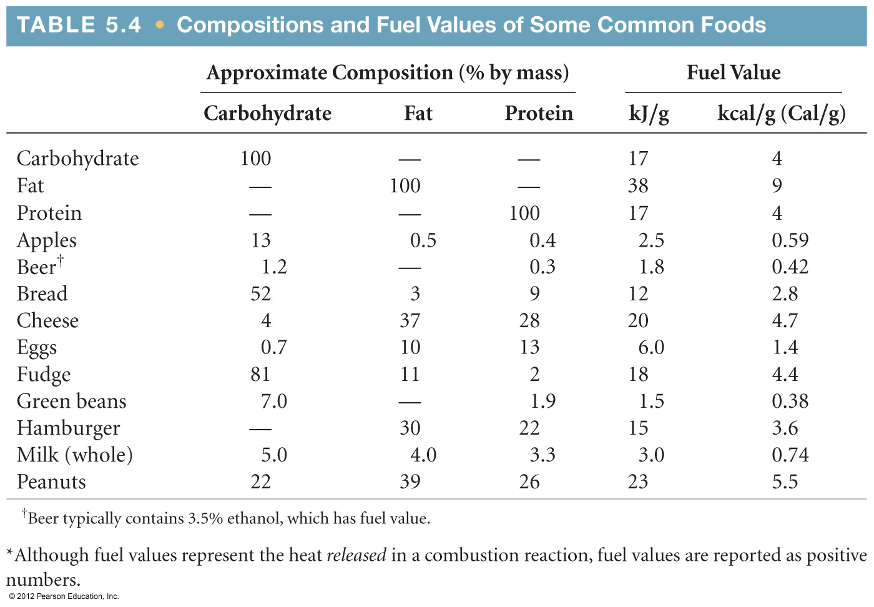
Energy in Foods
Most of the fuel in the food we eat comes from carbohydrates and fats.

Slide 35
Fossil fuels originated millions of years ago when aquatic plants and animals were buried and compressed by layers of sediment at the bottoms of swamps and seas.
Over time this organic matter was converted by bacterial decay and pressure to petroleum (oil), gas, and coal.

Slide 36
Coal, which accounts for 22.9% of total U.S. energy consumption, varies in terms of the amount of carbon it contains and so varies in terms of the amount of energy it produces in combustion.
Anthracite (hard coal) was laid down as long as 250 million years ago and can contain as much as 80% carbon. Bituminous coal, a younger variety, contains between 45% and 65% carbon.

Slide 37
Natural gas, which accounts for 22.7% of total U.S. energy consumption, is convenient because it is fluid and can be easily transported. Purified natural gas is primarily methane, CH₄, plus small amounts of ethane, C₂H₆; propane, C₃H₈; and butane, C₄H₁₀.
Petroleum is a mixture of compounds. Gasoline, which is obtained from petroleum, is a mixture of hydrocarbons (compounds of carbon and hydrogen).

Slide 38
The main issue with natural gas and petroleum is their relatively short supply. It has been estimated that petroleum deposits will be 80% depleted by 2030. Natural gas deposits may be depleted even sooner.
Coal deposits, however, are expected to last for several more centuries. This has led to the development of commercial methods for converting coal to the more easily handled liquid and gaseous fuels.

Slide 39
Coal gasification is one way. Steam is passed over hot coal:
C(s) + H₂O(g) → CO(g) + H₂(g)
The mixture containing carbon monoxide can be converted by various methods into useful products.
The mixture of carbon monoxide and hydrogen can be converted by various methods into useful products such as methane, CH₄.
CO(g) + 3H₂(g) → CH₄(g) + H₂O(g)

Slide 40
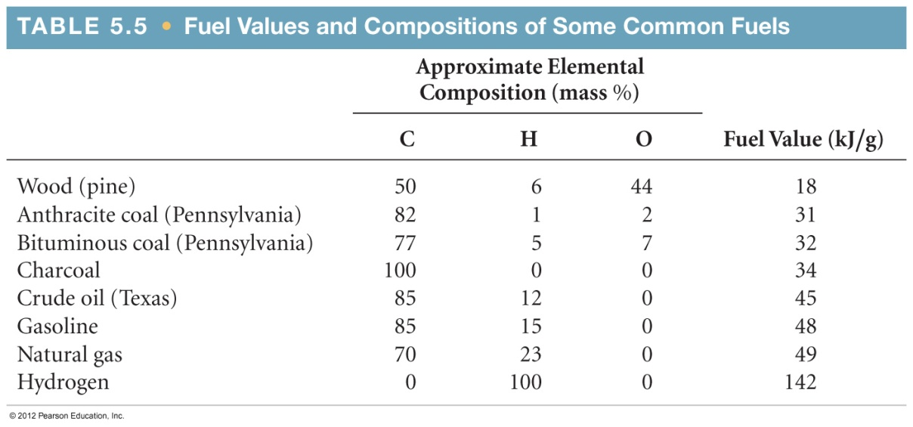
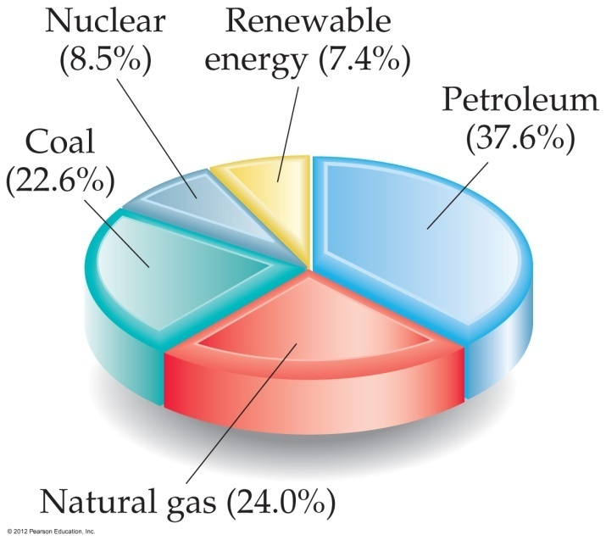
Energy in Fuels
The vast majority of the energy consumed in this country comes from fossil fuels.

